Slide 1

APEX INSTITUTE OF TECHNOLOGY
DEPARTMENT OF COMPUTER SCIENCE & ENGINEERING
Computer Organization & Architecture (21CSH-281)
Faculty: Siddharth Kumar (E12853)
Lecture - 6
Instruction set architecture of a CPU: Instruction Execution Cycle
DISCOVER . LEARN . EMPOWER

Slide 2
Computer Organization & Architecture: Course Objectives
COURSE OBJECTIVES
The course aims to:
The purpose of the course is to introduce principles of computer organization and the basic architectural concepts.
It begins with basic organization, design, and programming of a simple digital computer and introduces simple register transfer language to specify various computer operations.
Topics include computer arithmetic, instruction set design, microprogrammed control unit, pipelining and vector processing, memory organization and I/O systems, and multiprocessors.
To familiarize Students with the detailed Architectures of a Central Processing Unit.
Learn the different types of serial communication techniques.

Slide 3
COURSE OUTCOMES
On completion of this course, the students shall be able to:-
CO1 | Identify and interpret the basics of instruction sets and their impact on the design, organization, and functionality of various functional units of a computer comparable to the CPU, memory organization, I/O organization, and parallel processors.
CO2 | Analysis of the design of arithmetic & logic unit and understanding of the fixed point and floating-point arithmetic operations.
CO3 | Relate cost performance and design trade-offs in designing and constructing a computer processor which includes memory.
CO4 | Understanding the different ways of communicating with I/O devices and standard I/O interfaces.
CO5 | Implementation of control unit techniques and the concept of Pipelining.

Slide 4
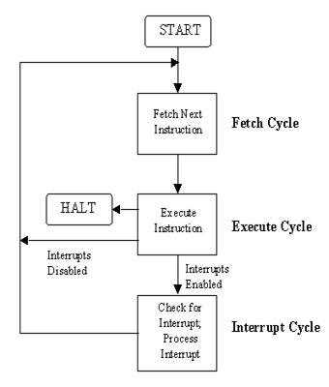
Instruction Execution Cycle
All computers have an instruction execution cycle.
A basic instruction execution cycle can be broken down into the following steps:
Fetch cycle
Execute cycle
Although we have been concentrating on the CPU and memory.
there are additional components in a computer such as the
I/O modules which can interact with the processor.
In an improved instruction execution cycle,
we can introduce a third cycle known as the interrupt cycle.
Figure illustrates how the interrupt cycle fits into the overall cycle.

Slide 5
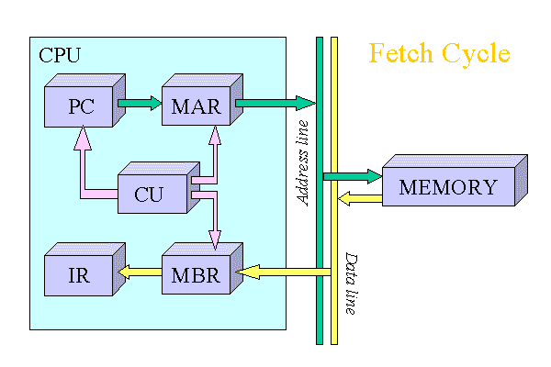
Fetch Cycle
To start off the fetch cycle, the address which is stored in the program counter (PC) is transferred to the memory address register (MAR).
The CPU then transfers the instruction located at the address stored in the MAR to the memory buffer register (MBR) via the data lines connecting the CPU to memory. This transfer from memory to CPU is coordinated by the control unit (CU).
To finish the cycle, the newly fetched instruction is transferred to the instruction register (IR) and unless told otherwise, the CU increments the PC to point to the next address location in memory.

Slide 6
The illustrated fetch cycle above can be summarized by the following points:
PC => MAR
MAR => memory => MBR
MBR => IR
PC=PC+1
After the CPU has finished fetching an instruction, the CU checks the contents of the IR and determines which type of execution is to be carried out next.
This process is known as the decoding phase. The instruction is now ready for the execution cycle.

Slide 7
Execution Cycle
Once an instruction has been loaded into the instruction register (IR), and the control unit (CU) has examined and decoded the fetched instruction and determined the required course of action to take, the execution cycle can commence. Unlike the fetch cycle and the interrupt cycle, both of which have a set instruction sequence, the execute cycle can comprise some complex operations (commonly called opcodes). The actions within the execution cycle can be categorized into the following four groups:
CPU - Memory: Data may be transferred from memory to the CPU or from the CPU to memory.
CPU - I/O: Data may be transferred from an I/O module to the CPU or from the CPU to an I/O module.
Data Processing: The CPU may perform some arithmetic or logic operation on data via the arithmetic-logic unit (ALU).
Control: An instruction may specify that the sequence of operation may be altered. For example, the program counter (PC) may be updated with a new memory address to reflect that the next instruction fetched, should be read from this new location.
For simplicity reasons, the following examples will deal with two operations that can occur.

Slide 8
The [LOAD ACC, memory] and [ADD ACC, memory], both of which could be classified as memory reference instructions. Instructions which can be executed without leaving the CPU are referred to as non-memory reference instructions.
LOAD ACC, Memory
This operation loads the accumulator (ACC) with data that is stored in the memory location specified in the instruction. The operation starts off by transferring the address portion of the instruction from the IR to the memory address register (MAR). The CPU then transfers the instruction located at the address stored in the MAR to the memory buffer register (MBR) via the data lines connecting the CPU to memory. This transfer from memory to CPU is coordinated by the CU. To finish the cycle, the newly fetched data is transferred to the ACC.
1 The illustrated LOAD operation (Figure 4) can be summarized in the following points:
2 IR [address portion] => MAR
3 MAR => memory => MBR
4 MBR => ACC

Slide 9
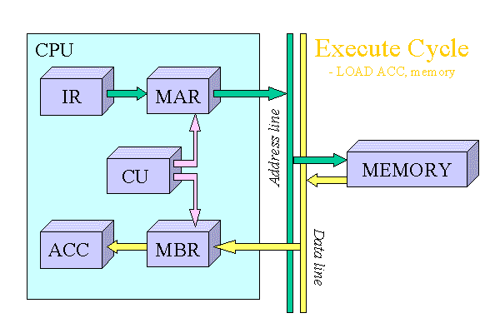
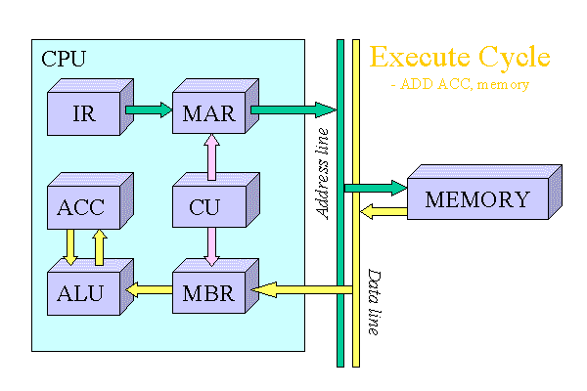
ADD ACC, memory
This operation adds the data stored in the ACC with data that is stored in the memory location specified in the instruction using the ALU. The operation starts off by transferring the address portion of the instruction from the IR to the MAR. The CPU then transfers the instruction located at the address stored in the MAR to the MBR via the data lines connecting the CPU to memory. This transfer from memory to CPU is coordinated by the CU. Next, the ALU adds the data stored in the ACC and the MBR. To finish the cycle, the result of the addition operation is stored in the ACC for future use.

Slide 10
After the execution cycle completes, if an interrupt is not detected, the next instruction is fetched and the process starts all over again.
Interrupt Cycle
An interrupt can be described as a mechanism in which an I/O module etc., can break the normal sequential control of the central processing unit (CPU). Table below, summarizes the most common form of interrupts that the CPU can receive.
The main advantage of using
interrupts is that the processor
can be engaged in executing
other instructions while the I/O
modules connected to the
computer are engaged in other
operations.
Program | Generated by some condition that occurs as a results of an instruction execution, such as arithmetic overflow, division by zero, attempt to execute am illegal machine instruction, and reference outside a user's allowed memory space.
Timer | Generated by a timer within the processor. This allows the operating system to perform certain functions on a regular basis.
I/O | Generated by an I/O controller, to signal normal completion of an operation or to signal a variety of error conditions.
Hardware Failure | Generated by a failure such as power failure or memory parity error.

Slide 11
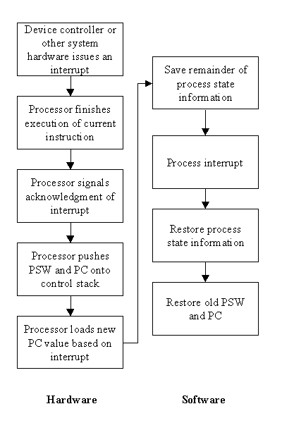
Up until now we have dealt with the instruction execution cycle on the hardware level. When interrupts are introduced, the CPU and the operating system driving the system, is responsible for the suspension of the program
currently being run, as well as restoring that program at the same point before the interrupt was detected. To handle this, an interrupt handler routine is executed. This interrupt handler is usually built into the operating system.
Before the interrupt handler routine can ran, several processes must
occur first. A typical sequence of events is illustrated in Figure.
After the completion of the interrupt handler routine, the normal
sequential fetch / execute cycle begins.

Slide 12
Summary
Discussed about Instruction Execution Cycle.
Discussed about Fetch cycle.
Discussed about Execution cycle.
Assessment Questions
Q1. What is the memory address register?
Q2. What is the memory buffer register?
Q3. What are instruction register?
Q4. What is interrupt cycle?
Q5. What is indirect CYCLE

Slide 13
THANK YOU

